Slide 1
Seasonal Births

Slide 2
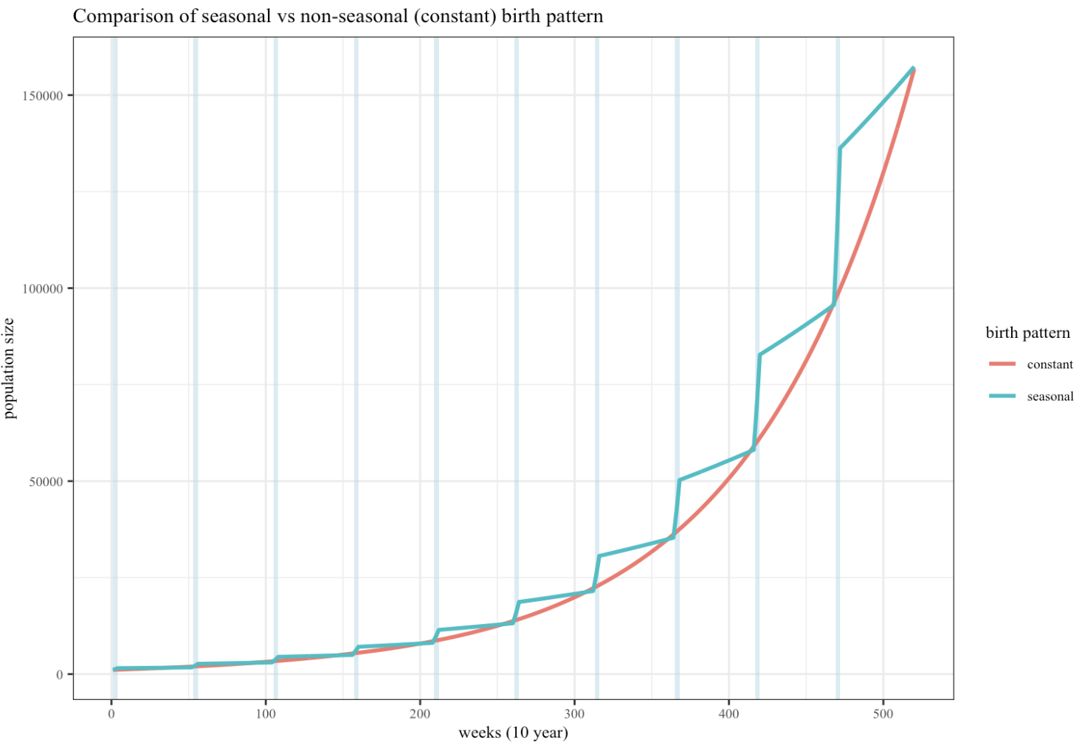
A crude test of the model :seasonal vs non seasonal
A = seasonal
70% all births occur in first 4 weeks of the year
30% in the remaining 48 weeks
B = non-seasonal
Input:
Starting pop of 1000
ONLY births (no offtake)
10 year simulation period

Slide 3
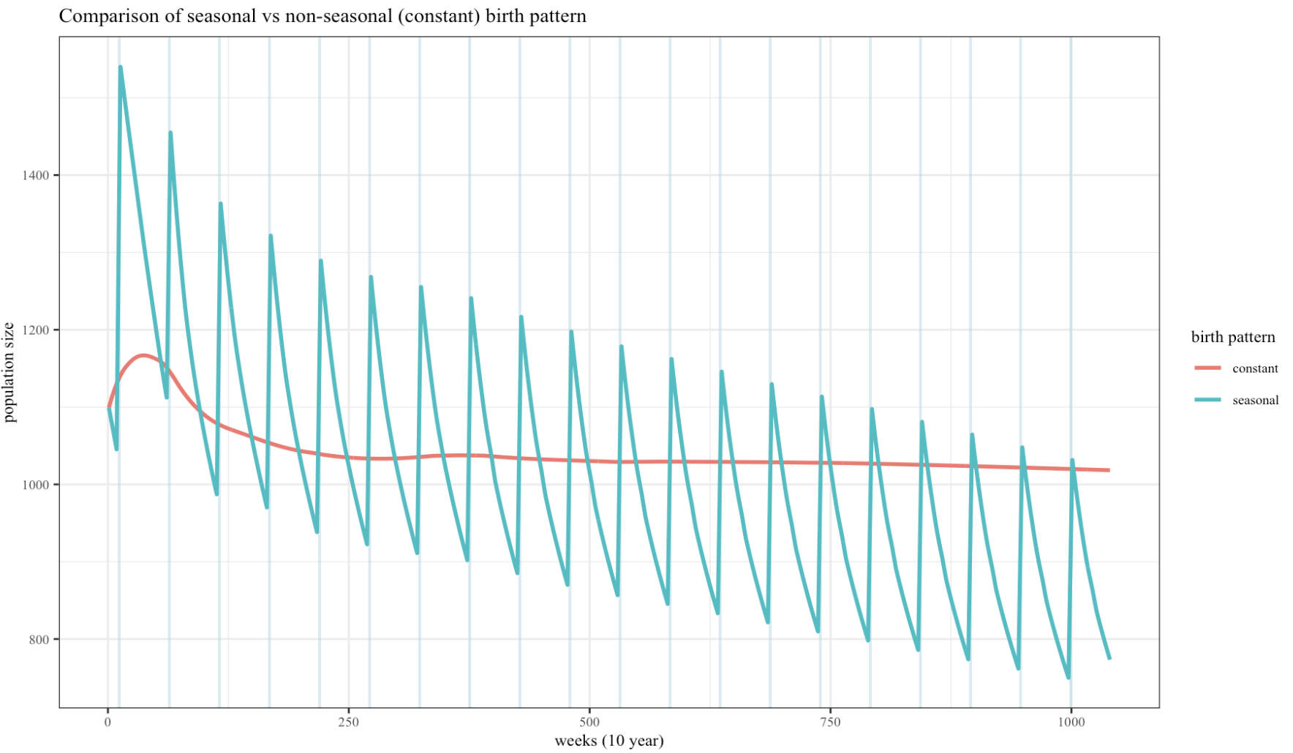
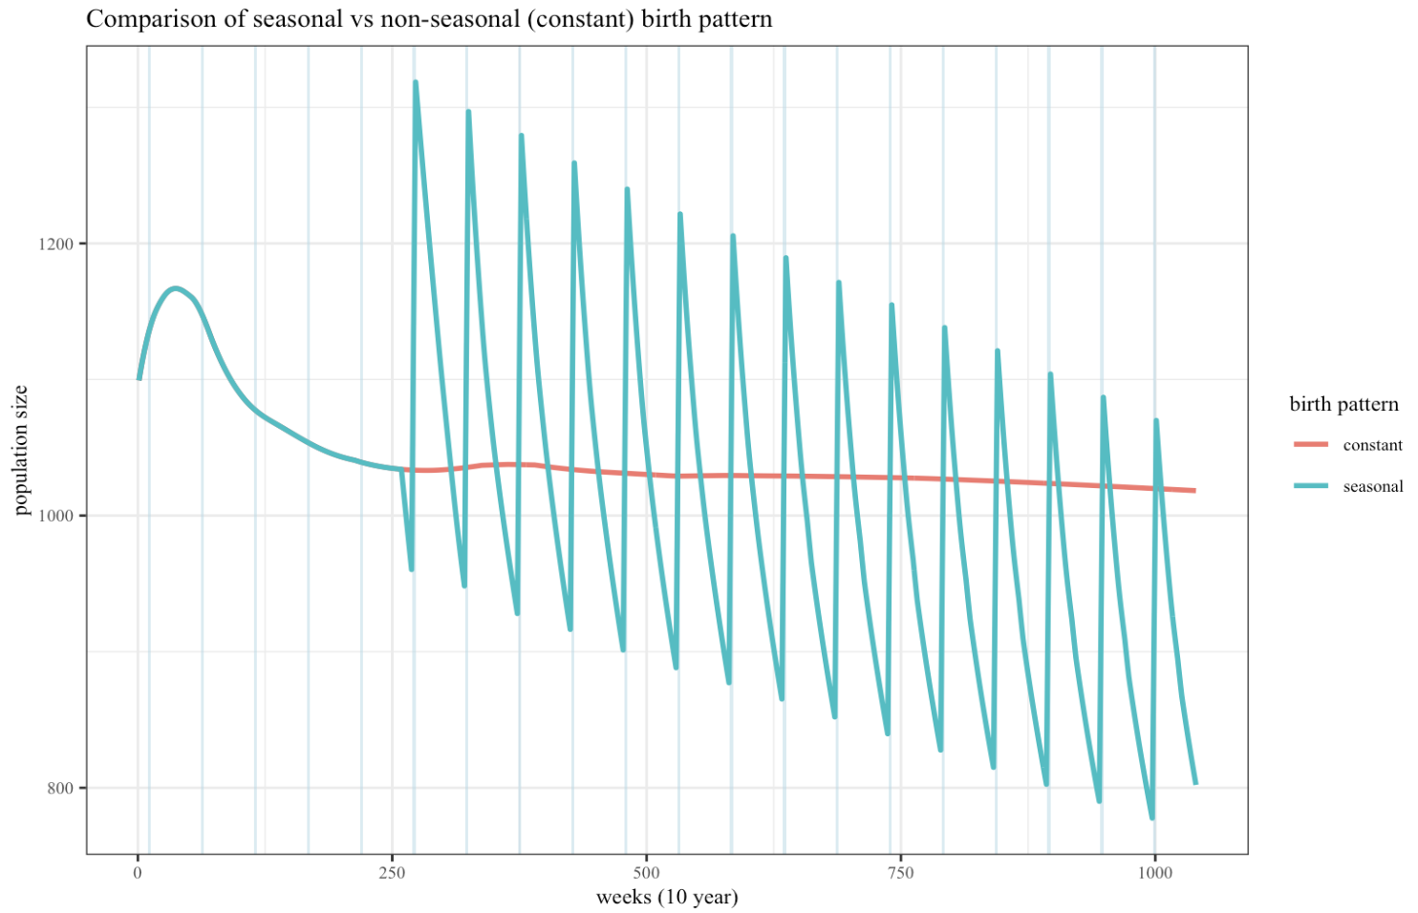
Otte & Chilonda – arid, pastoral, goat
Birth peaks at month 3 each year, lasting 4 weeks .
Weeks 10-13
OC Data – less good
Because proportions of animals fluctuate the actual numbers being removed from the population are larger?
Maybe also due to the model not being at stable state when initiated (NO >>>)
Notes:
- calc births per year from constant model
- force constant no. of births py basedo n this
- adapt seasonal model to same number of births (with peak)

Slide 4
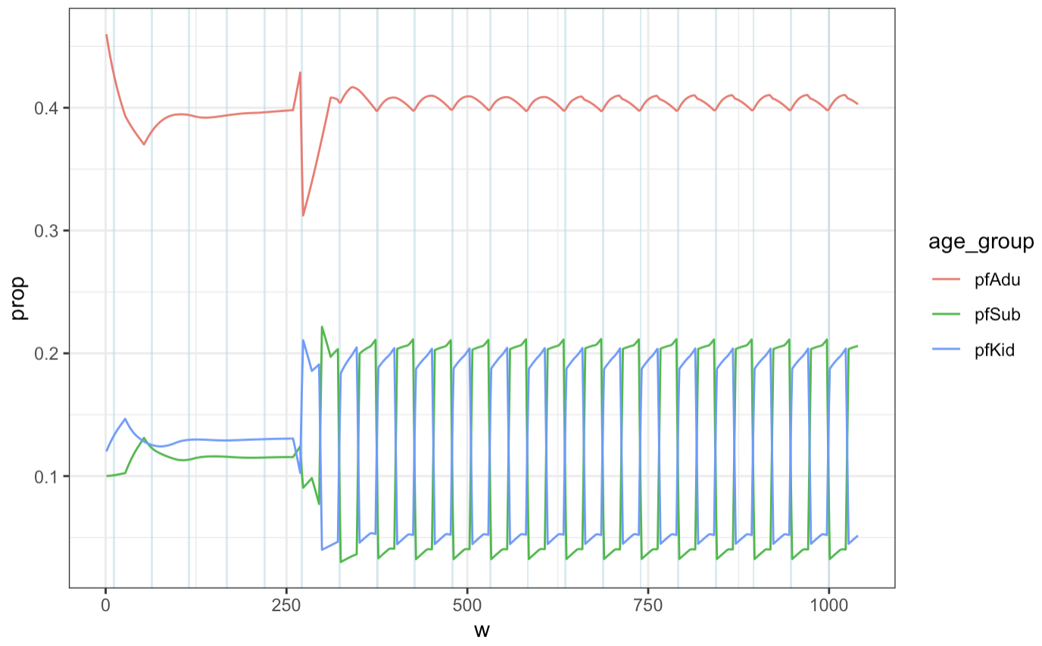
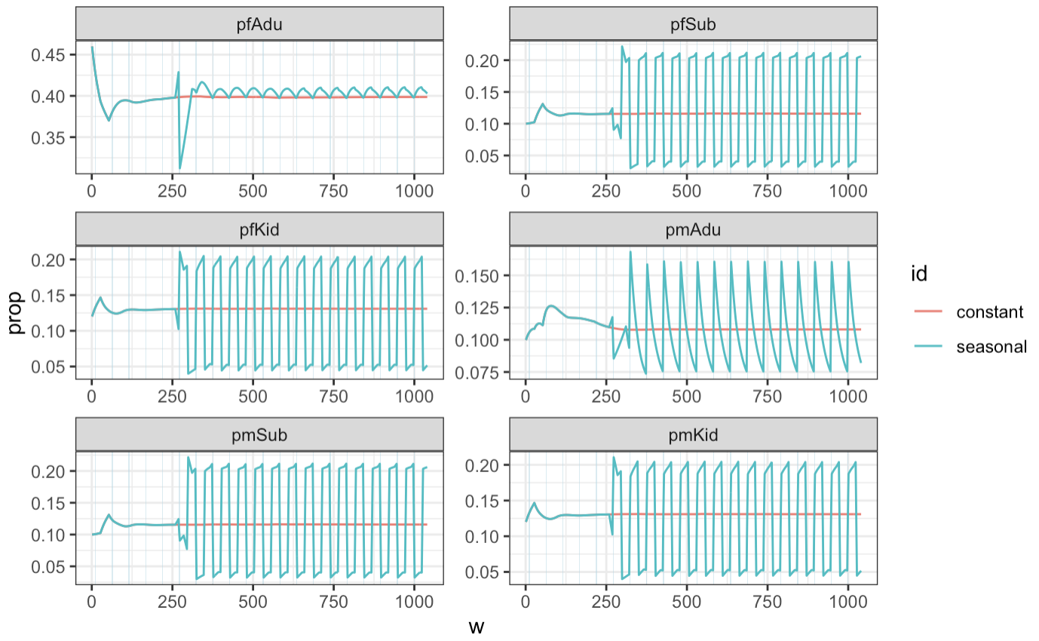
Diagnostics…

Slide 5
Immunity Dynamics with Seasonality – Otte & Chilonda example
Parameter sets:
Generated by LHS of reported ranges for different flock types in O&C
“Validated” against flock growth & age-sex structure conditions
Parameter sets which failed satisfy conditions were discarded.
Births:
Seasonal birth peaks: 70% aggregated in 4-week period (30% spread throughout rest of year)
Seasonality implemented from 5 years into simulation
Occurrence of peak at months: 3, 6, 9, 12
Include non-seasonal example
Vaccination:
At mid-point (10y),
pV = 1
4 year strategy
Immunity metrics for 1st campaign
Simulation:
20y
All animals initially S
Maternal immunity included (and included in reported immunity rates)

Slide 6
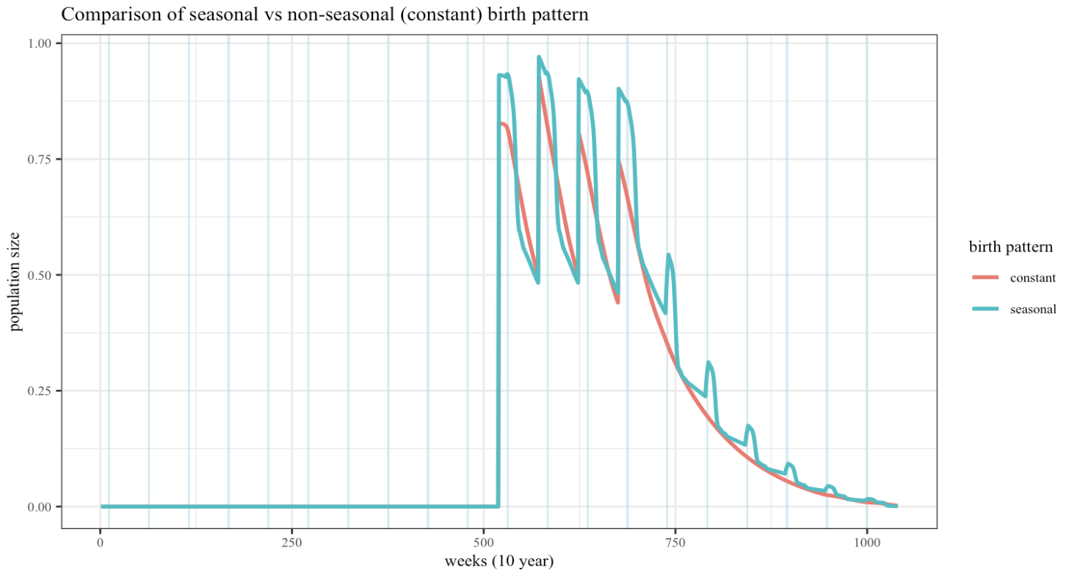
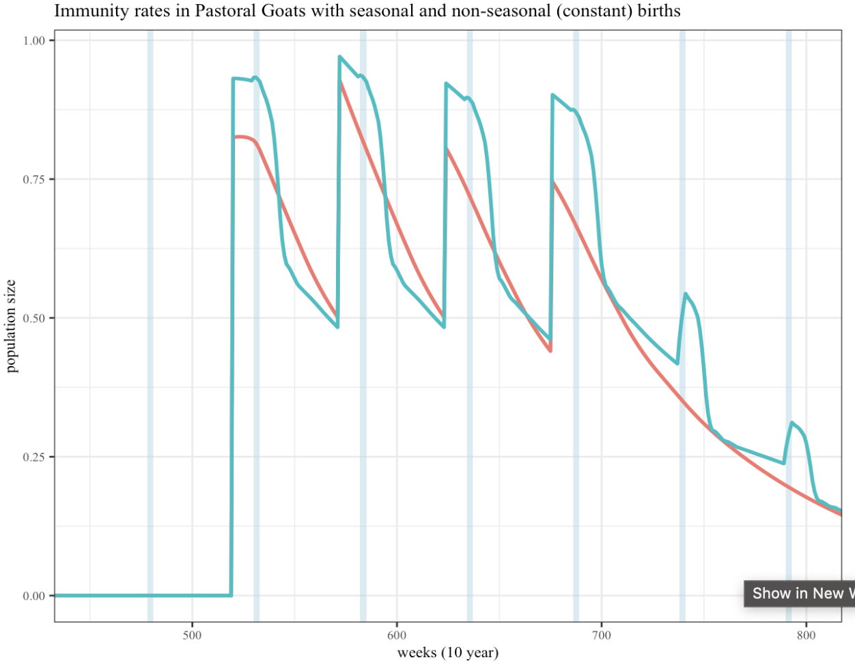
Vaccination in 1st month of year (weeks 520, 572, 624, 676) & within 1 timestep (week)
Birth peak at 3rd month (week 10) ~ (weeks 530,582,634,686) & over 4 week period

Slide 7
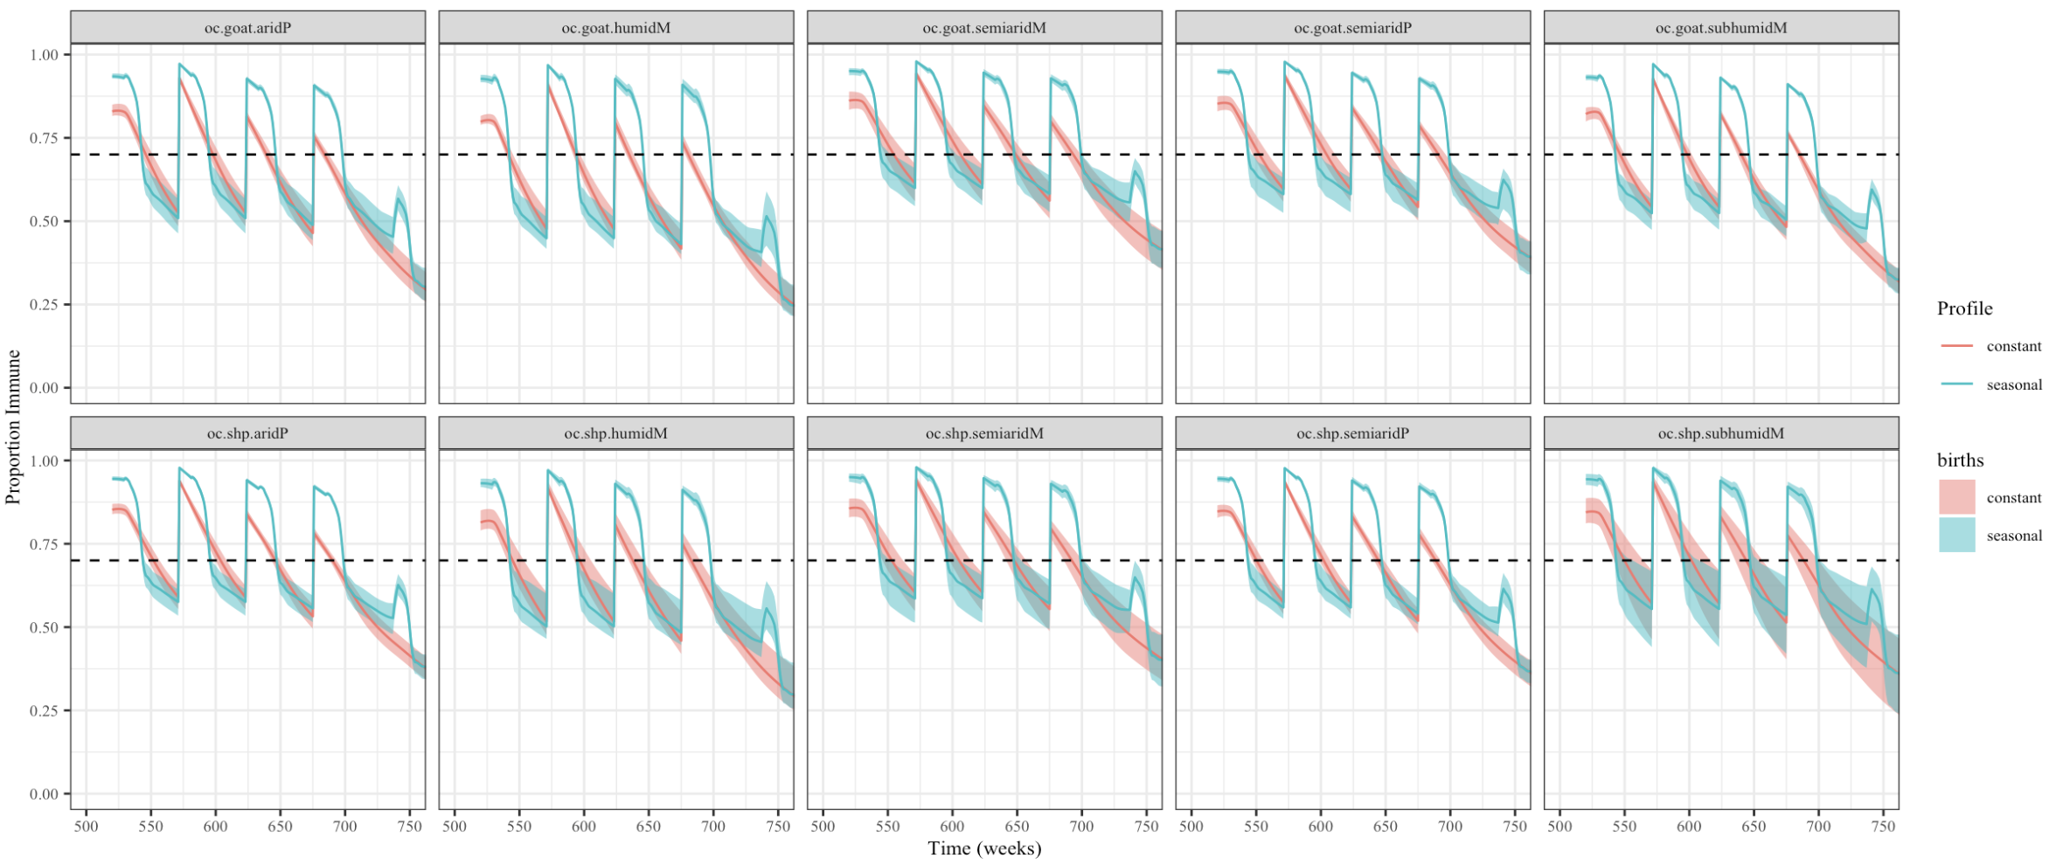
Vaccination occurs in 1st month of year (weeks 520, 572, 624, 676) & within 1 timestep (week)
Birth peak occurs at 3 months (week 10) ~ 9 weeks post vaccination (weeks 530,582,634,686)

Slide 8
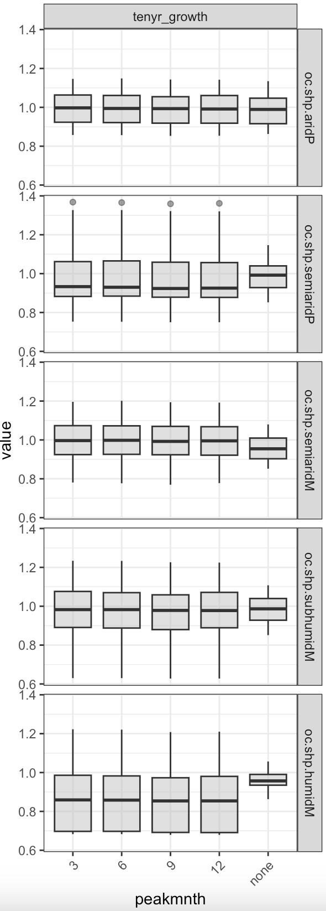
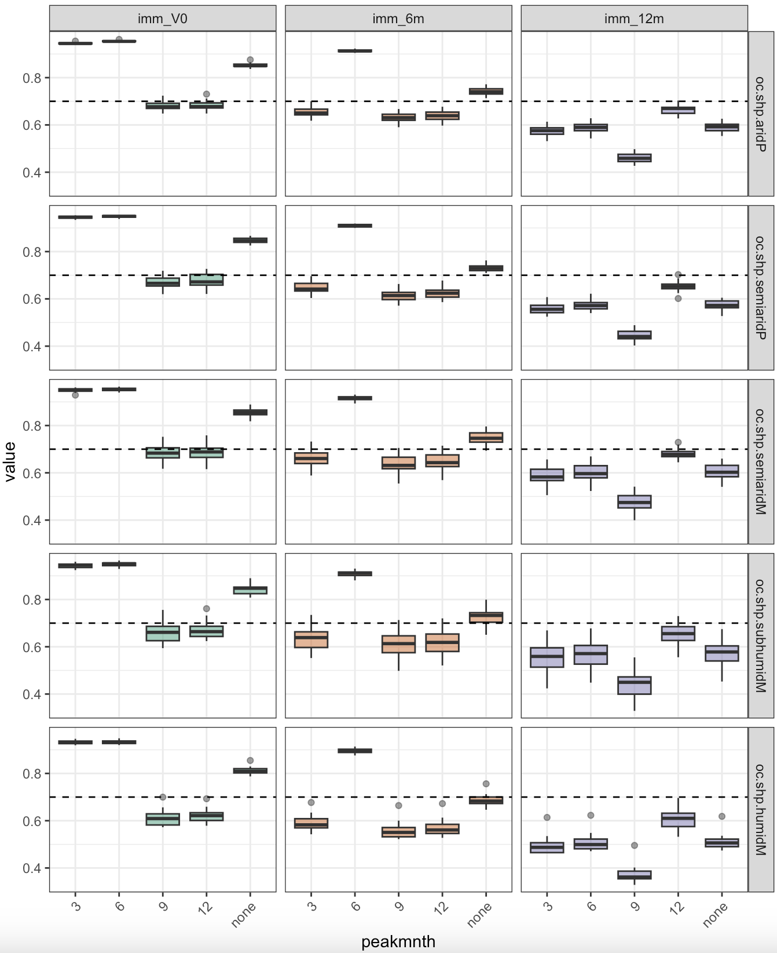
The residual post-vaccination immunity rate one year after vaccination was little influenced by the vaccination date. Nonetheless, the highest rates were obtained when the vaccination campaign occurred between December and May: hammami 2016

Slide 9
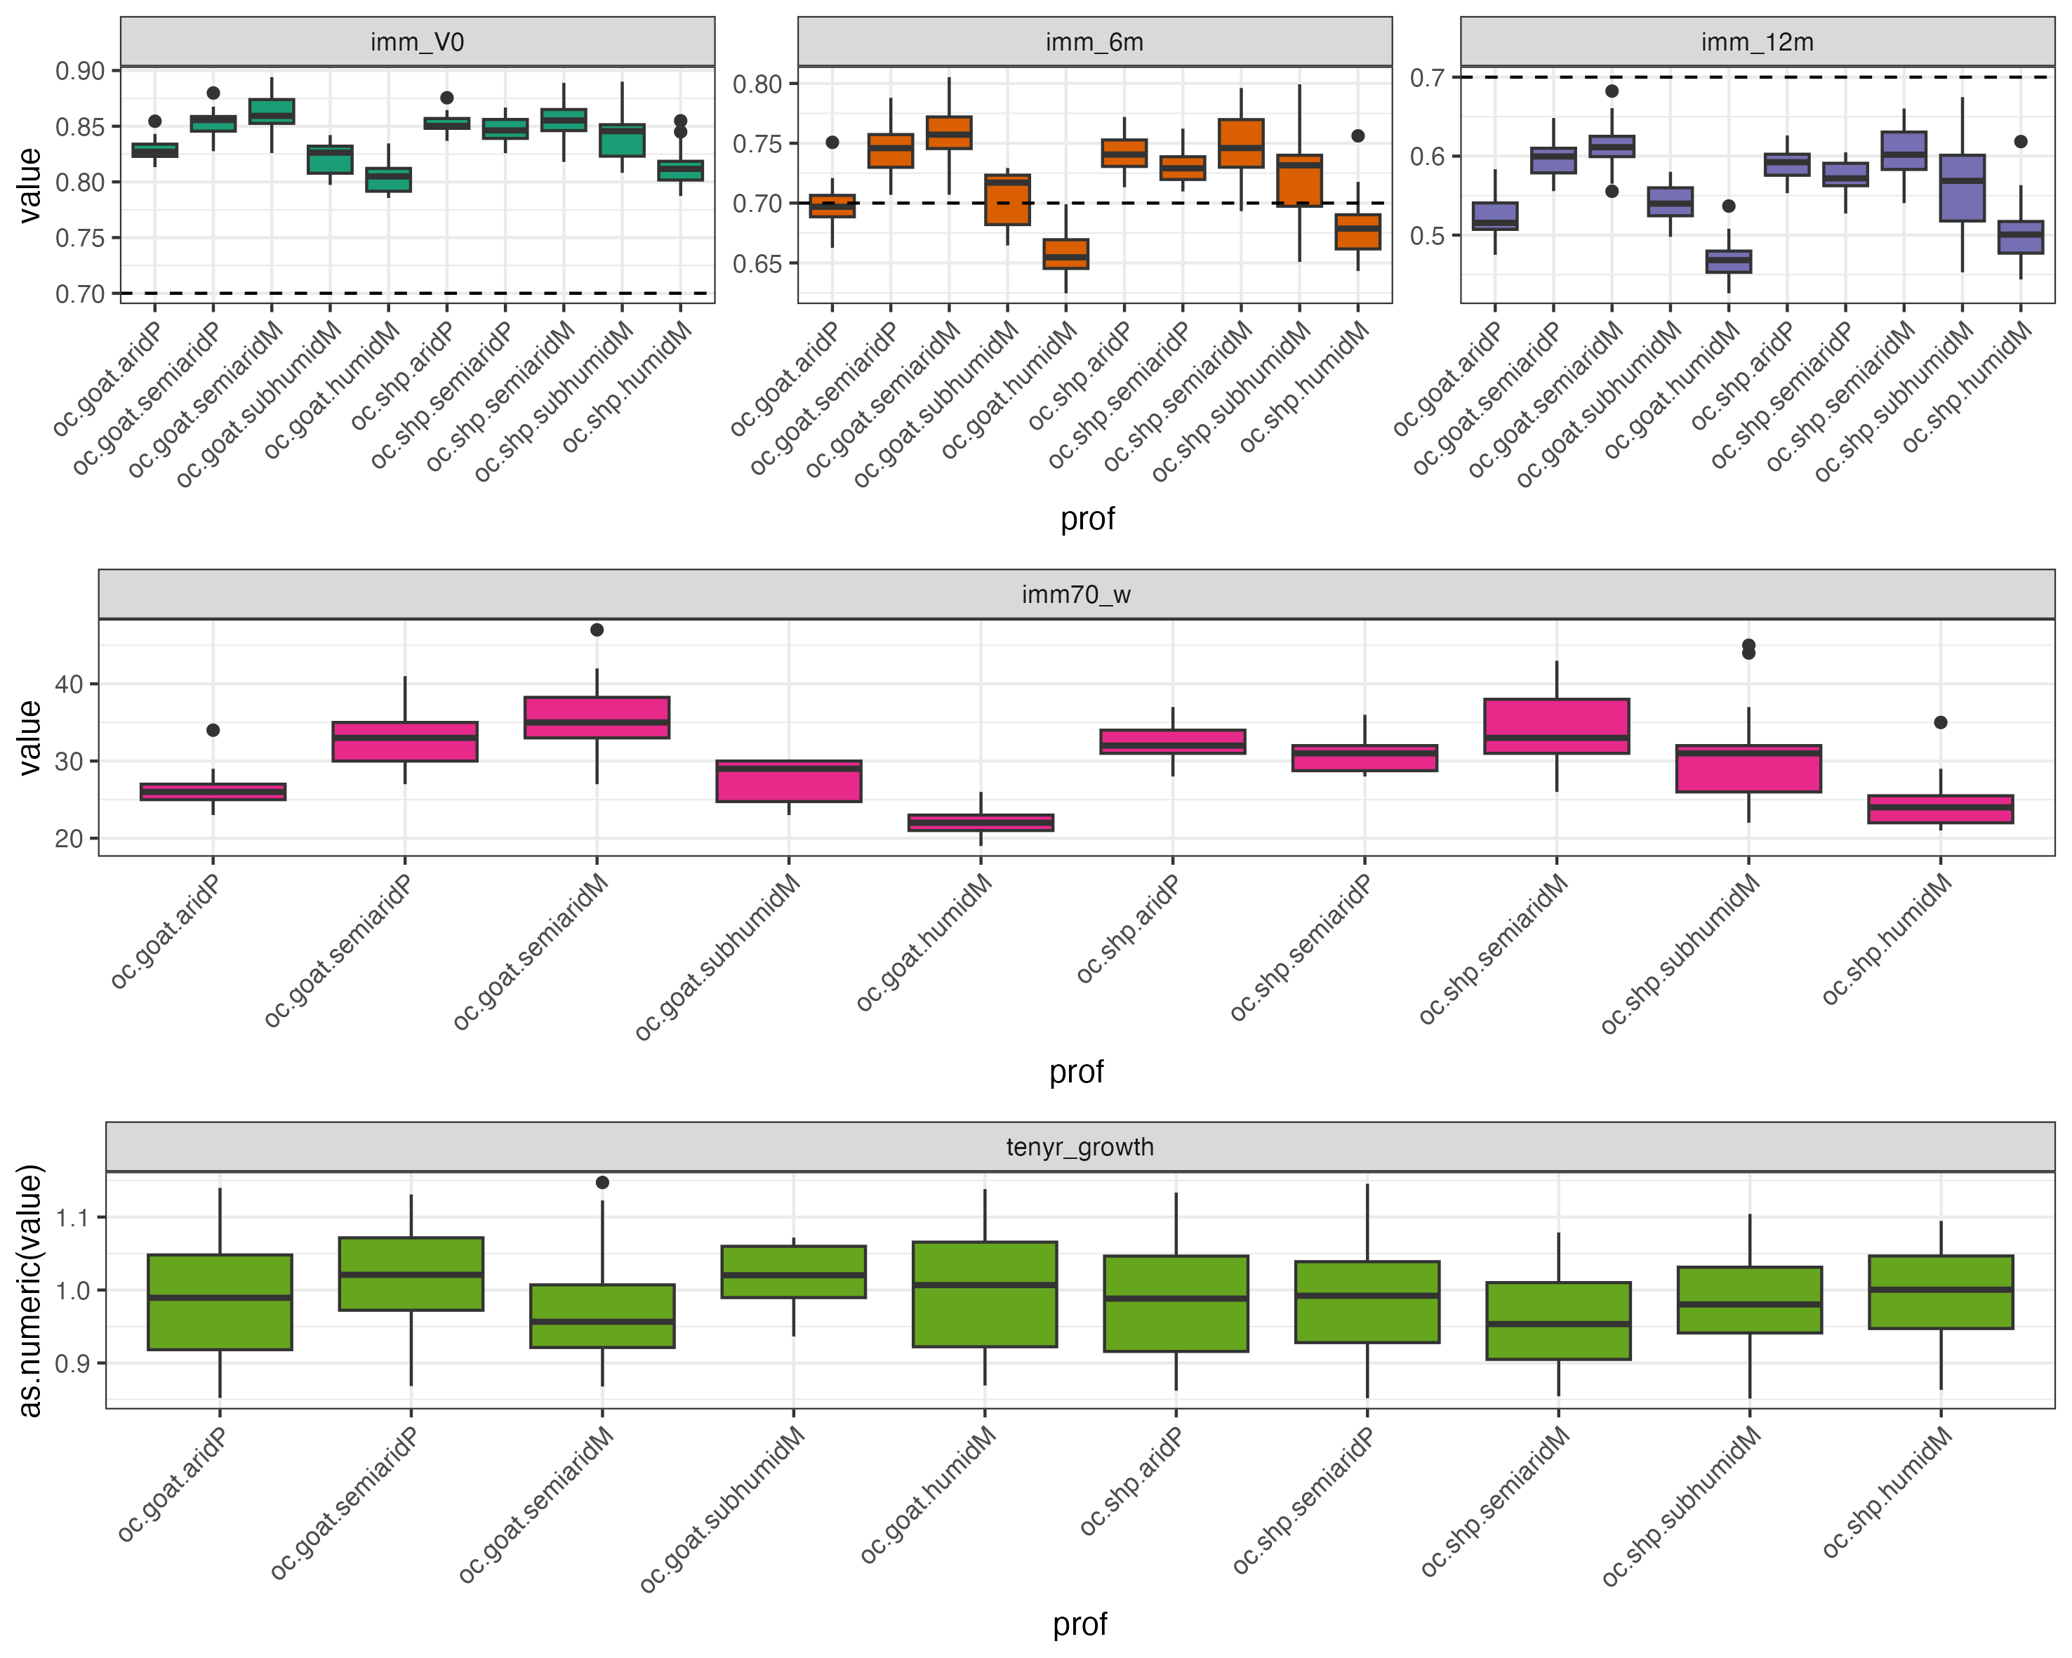
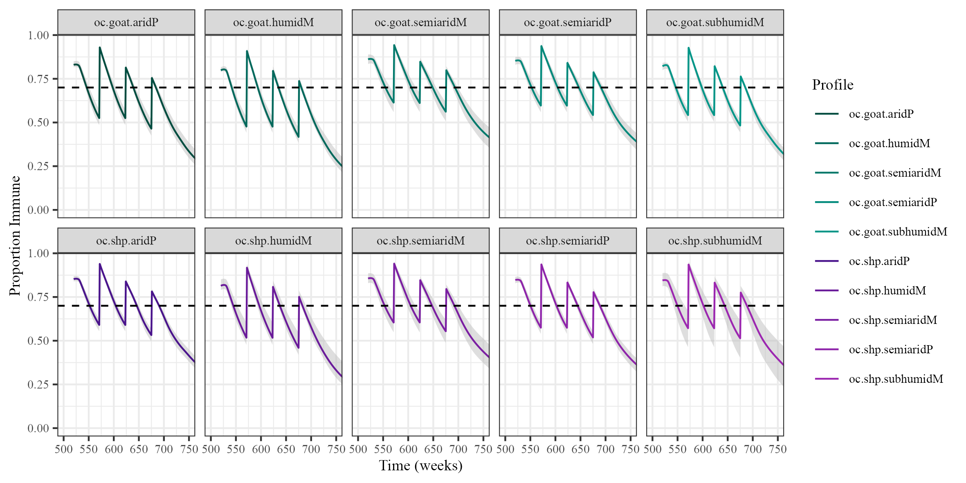
Non-seasonal

Slide 10
Births Round 2: Fixed vs Variable seasonal births

Slide 11
Applied_render-lhs_OC-check_seasonal.Rmd compares seasonal fixed and seasonal variable
Applied_render-lhs_OC-validVac_seasonalfixed.Rmd compares seasonal fixed and non-seasonal fixed

Slide 12
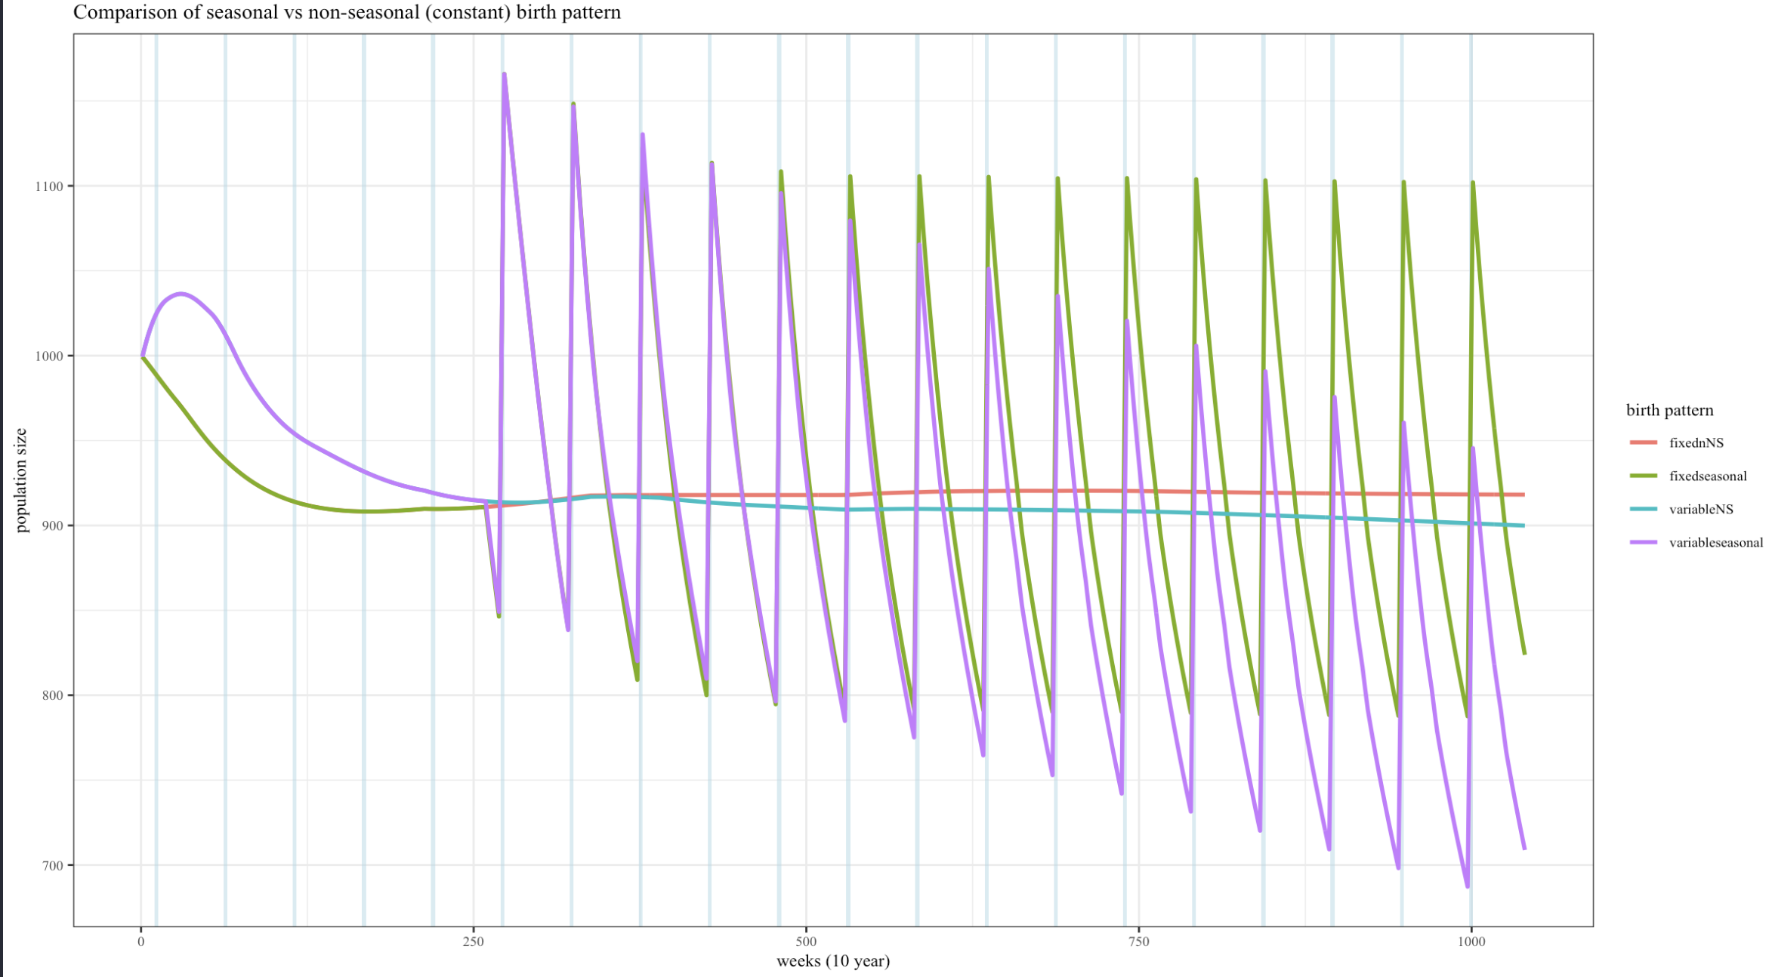

Slide 13
Updated results

Slide 14
Question: what output is useful ?
Imm metrics: immunity at V0, 6m, 12m and time to 70% for 1st campaign only
Want a measure of performance over whole vaccination period (or longer e.g. 6 years to 2030)
Calculate weeks >70% immunity per flock profile over the 4 year vaccination period?

Slide 15
